Slide 1
DAILY EXPENSE TRACKER
DONE BY:
G.MOHIT SAI BALAJI(RA2211026010142)
M.ABHIRAM SAI(RA2211026010152)
L.PRAVALLIKA(RA2211026010143)

Slide 2
INTRODUCTION
Managing daily expenses is a crucial part of financial planning, yet many people struggle to keep track of their spending. Our Daily Expense Tracker is designed to provide users with a simple, efficient, and AI-driven solution to monitor, analyze, and optimize their expenses.
With an intuitive interface and advanced analytics, the system allows users to log transactions, categorize expenses, set budgets, and receive insights into their spending habits. By leveraging machine learning and data visualization, our tracker helps users make informed financial decisions and promotes better money management.
The project integrates innovative features such as automated expense classification, predictive budget suggestions, and smart alerts to ensure users stay on top of their financial goals. Whether it's tracking monthly bills, daily purchases, or long-term savings, our solution offers a seamless way to gain control over personal finances.

Slide 3

BUSINESS CASE
Business Problem:
Many individuals struggle with financial management due to:
Lack of awareness of spending habits.
Difficulty in maintaining a consistent budget.
Inability to visualize financial data for informed decisions.
This often leads to overspending, debt, and missed financial goals.

Slide 4
BUSINESS CASE
Proposed Solution:
Develop a user-friendly Daily Expense Tracker application that provides:
1. Real-Time Expense Tracking: Simplify logging of daily income and expenses.
2. Categorization of Spending: Organize transactions by categories for better analysis.
3. Visualization of Financial Data: Generate reports and charts for actionable insights.
4. Budget Management Tools: Assist users in setting and maintaining budgets.
5. Data Export and Backup: Ensure secure handling and portability of financial data.

Slide 5
LIMITATIONS IN EXISTING SYSTEMS
While many expense tracking solutions exist, they often come with several limitations that affect their usability, accuracy, and overall effectiveness. Some key limitations include:
Manual Data Entry – Many existing apps require users to input each transaction manually, making the process time-consuming and prone to human errors.
Limited AI & Automation – Most systems lack intelligent automation for categorizing expenses or predicting future spending patterns, leading to inefficient financial planning.
Poor Integration with Banks & Wallets – Some expense trackers do not support seamless integration with bank accounts, credit cards, or digital wallets, requiring users to manually reconcile their transactions.
Lack of Personalized Insights – Many systems fail to provide deep insights, such as spending trends, budget recommendations, or alerts for unusual transactions.
Security & Privacy Concerns – Some platforms may not have strong data encryption or privacy measures, putting sensitive financial data at risk.
Limited Multi-User Support – Most trackers are designed for single users and do not support shared financial management for families or businesses.
Inflexible Budgeting Features – Many apps offer rigid budgeting tools that do not adapt to changing financial goals or irregular income patterns.

Slide 6
USER STORIES
1. Overview Dashboard
As a user, I want to see a summary of my financial data on a single dashboard, so that I can quickly understand my overall financial status. Acceptance Criteria:
The dashboard displays total income, total expenses, and remaining balance for the selected period.
Key metrics (e.g., highest spending category, upcoming recurring expenses) are prominently featured.
Users can customize the layout by selecting which widgets to display.
2. Category-Based Visualization
As a user, I want to see how much I’ve spent in each category, so that I can identify where most of my money is going. Acceptance Criteria:
The system provides a pie chart or bar graph showing expenses by category.
Users can hover over chart sections to see detailed amounts and percentages.
Filters are available to view data for specific time ranges (e.g., weekly, monthly).

Slide 7
USER STORIES
3. Trends Over Time
As a user, I want to view my spending trends over time, so that I can see whether my expenses are increasing or decreasing. Acceptance Criteria:
The system displays a line graph of expenses over time (daily, weekly, monthly).
Users can toggle between cumulative and non-cumulative trends.
The graph highlights anomalies (e.g., unusually high expenses).
4. Budget Tracking
As a user, I want to see how much of my budget I’ve used in each category, so that I can adjust my spending accordingly. Acceptance Criteria:
The dashboard shows a progress bar or donut chart for each budget category.
Categories exceeding the budget are highlighted (e.g., in red).
Users can drill down to see which transactions contributed to the category total.

Slide 8
USER STORIES
5. Expense Comparison Dashboard
As a user, I want to compare my expenses across different periods, so that I can analyze changes in my spending behavior. Acceptance Criteria:
A bar graph compares expenses across two or more time periods (e.g., this month vs. last month).
The system calculates percentage increases or decreases in each category.
Users can switch between category-specific and overall comparisons.
6. Geographical Visualization
As a user, I want to see my expenses mapped geographically, so that I can understand spending patterns by location. Acceptance Criteria:
The system displays a map with markers for locations where expenses occurred.
Markers are sized or colored based on the amount spent.
Users can filter the map by time range and categories.

Slide 9
USER STORIES
7. Expense Prediction Dashboard
As a user, I want to see projected expenses for the upcoming months, so that I can plan my finances better. Acceptance Criteria:
The system displays predicted expenses as a line or bar chart.
Predictions are broken down by category.
Users can adjust predictions based on planned changes (e.g., vacations, new recurring expenses).
8. Customizable Reports
As a user, I want to generate custom reports with selected data visualizations, so that I can analyze my finances in detail. Acceptance Criteria:
Users can choose data points (e.g., categories, date ranges) to include in the report.
The system generates a downloadable report in PDF or Excel format.
Visualizations in the report match those displayed in the dashboard.

Slide 10
USER STORIES
9. Database Design & Management
As a developer, I want to design a scalable and optimized database structure, so that the system can efficiently store and retrieve user expenses. Acceptance Criteria:
The database schema includes tables for users, transactions, categories, budgets, and AI-predicted expenses.
Query response time is optimized for large datasets.
Proper indexing and normalization techniques are used.
Secure user authentication and encryption are implemented for sensitive data.
10. AI-Based Expense Categorization
As a developer, I want to integrate an AI model that automatically categorizes expenses based on text and receipt uploads, so that users don’t have to manually classify their spending. Acceptance Criteria:
AI model processes expense descriptions and receipt images to determine the category.
The system achieves at least 85% accuracy in categorization.
Users can manually override the AI-suggested category.
The model improves over time using feedback-based learning.

Slide 11
PRODUCT VISION DOCUMENT
1. Audience:
Primary Audience:
Individuals looking to manage and track their daily expenses efficiently.
Young professionals and students who want to set and follow a budget.
Secondary Audience:
Financial advisors looking for a tool to help clients with expense tracking.
Families and groups who want to track shared expenses.
2. Needs:
Primary Needs:
An easy-to-use system for logging and categorizing expenses.
Real-time insights into spending habits.
Secure storage and backup of financial data.
AI-driven financial recommendations to improve savings.
Secondary Needs:
Integration with bank accounts for automatic expense tracking.
Multi-currency support for travelers.
Exporting financial reports for audits and tax purposes.

Slide 12
PRODUCT VISION DOCUMENT
3. Product:
Core Product: A mobile and web-based expense tracker that enables users to log, categorize, and analyze their daily expenses with AI-driven insights and budgeting tools.
Additional Features:
AI-based Spending Analysis: Provides personalized insights and suggests ways to save.
Expense Sharing: Allows users to split expenses with friends and family.
Multi-Currency Support: Enables tracking expenses in different currencies with real-time exchange rates.
Data Export: Provides CSV and PDF export options for records.
Notifications & Reminders: Alerts users about due payments and spending limits.
4. Values:
Core Values:
Financial Awareness: Helping users gain control over their finances.
Simplicity: Providing an intuitive interface for hassle-free expense tracking.
Differentiators:
AI-powered Insights: Uses machine learning to analyze spending patterns and provide financial advice.
Collaborative Expense Tracking: Enables group expense sharing for seamless cost management.

Slide 13
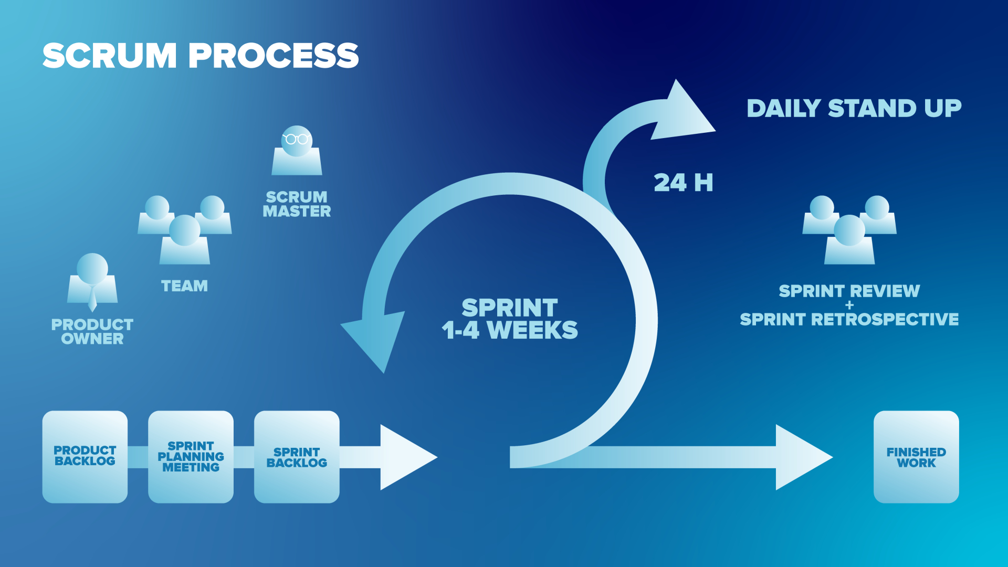

Slide 14
PRODUCT BACKLOG REFINEMENT
ID | Title | Epic | User Story | Priority (MoSCoW) | Status | Acceptance Criteria | Functional Requirements | Non-Functional Requirements | Original Estimate | Actual Effort (Days)
1 | User Registration & Authentication | User Management | As a user, I want to register and log in securely so that I can access my personal expense data. | Must Have | In Progress | User can create an account, log in, and log out securely. | Implement OAuth-based authentication, password encryption. | Ensure secure data storage and GDPR compliance. | 3 days | TBD
2 | Add Expense | Expense Management | As a user, I want to add an expense with details like amount, category, and date so that I can track my spending. | Must Have | To Do | User can add expense with mandatory fields. | Input fields for amount, category, date, and description. | Fast response time (<2 sec). | 3 days | TBD
3 | View Expense Summary | Data Visualization | As a user, I want to view my total expenses for the month so that I can manage my budget effectively. | Must Have | To Do | System generates a monthly summary with a breakdown by category. | Create an expense summary dashboard with charts using Plotly. | Ensure UI responsiveness and accessibility. | 4 days | TBD
4 | AI-based Spending Analysis | AI Insights | As a user, I want AI-driven insights into my spending patterns so that I can optimize my expenses. | Should Have | To Do | AI model suggests saving tips based on user spending habits. | Implement an ML model for anomaly detection and predictions. | Optimize for low-latency predictions. | 7 days | TBD
5 | Expense Sharing | Collaboration | As a user, I want to share expenses with friends so that we can track shared costs together. | Could Have | To Do | Users can create shared expense groups and split costs. | Implement group expense tracking with real-time updates. | Secure transactions and maintain accuracy. | 5 days | TBD

Slide 15
PRODUCT BACKLOG REFINEMENT
ID | Title | Epic | User Story | Priority (MoSCoW) | Status | Acceptance Criteria | Functional Requirements | Non-Functional Requirements | Original Estimate | Actual Effort (Days)
6 | Data Export | Report Generation | As a user, I want to export my expense data to CSV/PDF so that I can keep records for tax or auditing purposes. | Should Have | To Do | Users can export data in CSV and PDF formats. | Provide export options in multiple formats. | Data integrity and security compliance. | 3 days | TBD
7 | Notifications & Reminders | User Engagement | As a user, I want to receive reminders about upcoming bills and spending limits so that I can stay on top of my finances. | Should Have | To Do | Users get push/email notifications for bill payments. | Implement a notification system with customizable alerts. | Ensure minimal delay in notification delivery. | 4 days | TBD
8 | Multi-Currency Support | Global Accessibility | As a user, I want to track expenses in different currencies so that I can manage my finances while traveling. | Could Have | To Do | Users can add expenses in various currencies with automatic conversion. | Implement real-time currency conversion API. | Ensure accurate exchange rate updates. | 5 days | TBD

Slide 16
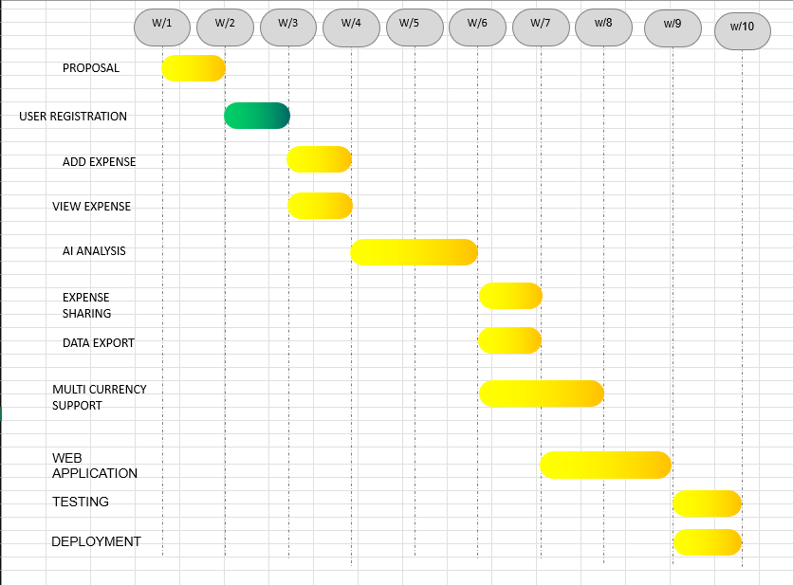
GANTT CHART

Slide 17
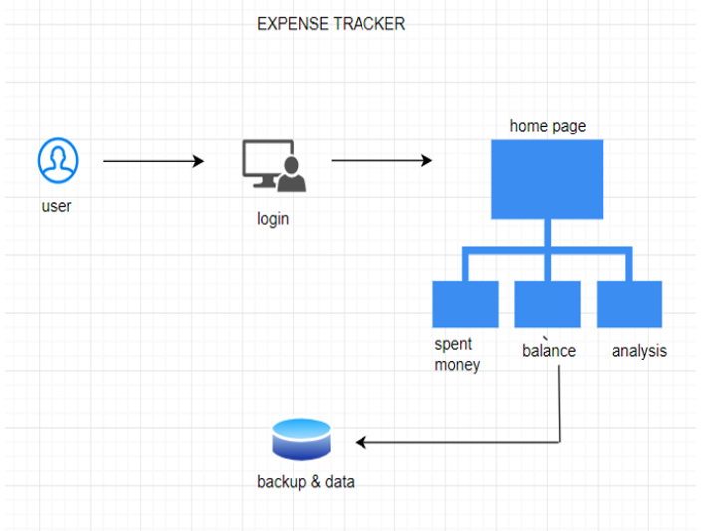
SYSTEM ARCHITECTURE

Slide 18
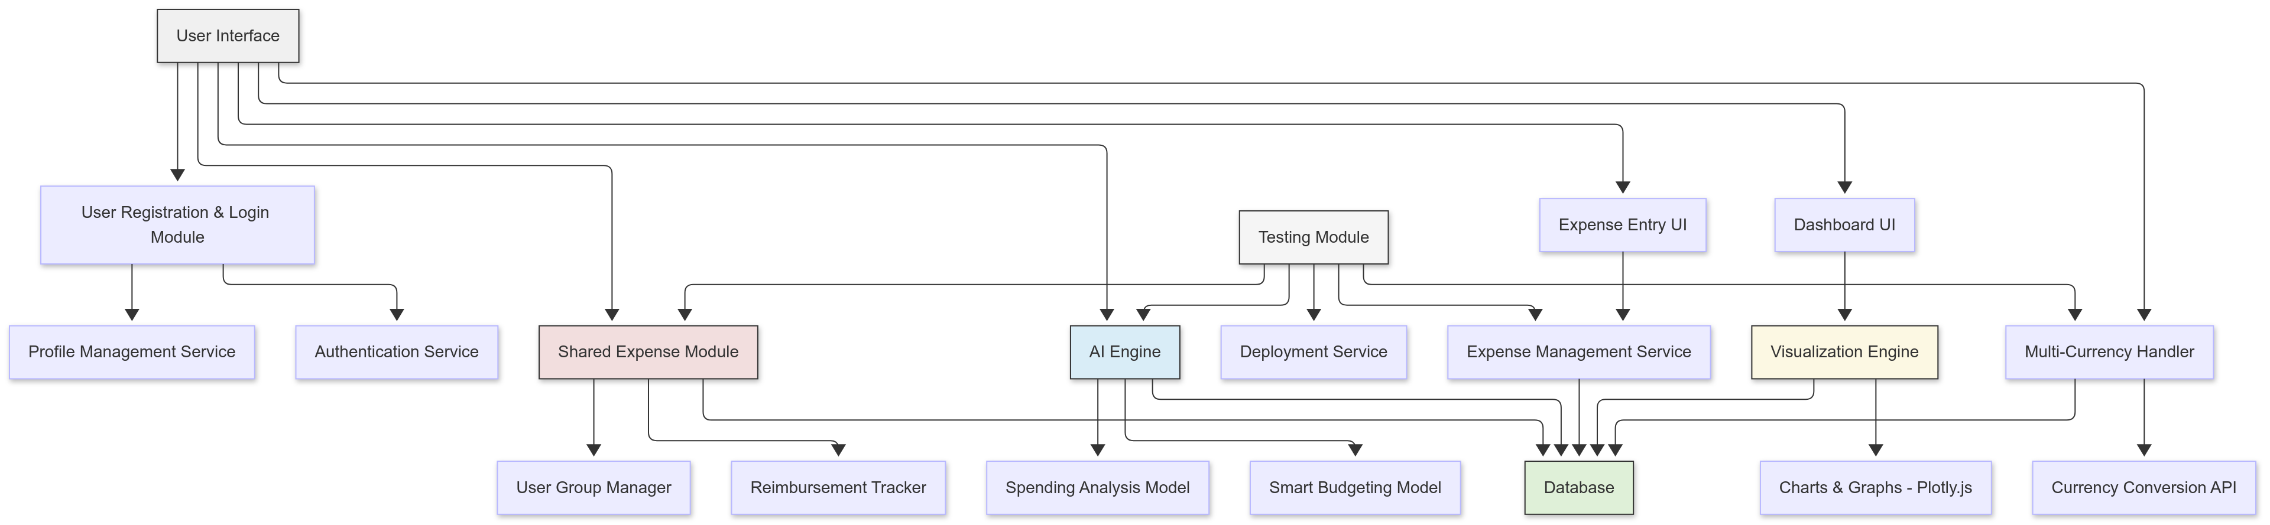
SYSTEM ARCHITECTURE

Slide 19
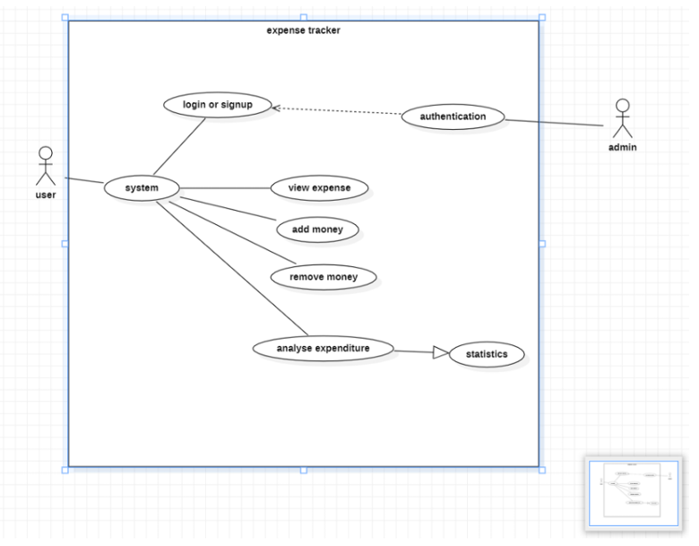
USE CASE
Export summary
Alert mails

Slide 20
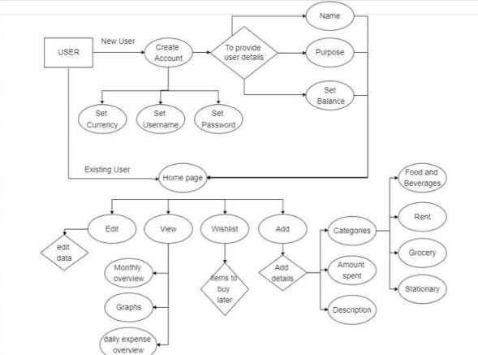
ER DIAGRAM
Export summary
Alert mails

Slide 21
SPRINT PLAN
📍 Sprint 1: User Registration & Authentication
📆 Focus: Enabling secure user authentication and profile management.
Sprint Backlog:
✅ User Registration (Email, Password, OAuth Login)
✅ User Login & Logout Functionality
✅ Role-Based Access Control (Admin/User)
✅ Profile Management (Edit User Details, Password Reset)
🎯 Sprint Goal: Ensure users can register, log in, and manage profiles securely.
📍 Sprint 2: Expense Management (Basic Features)
📆 Focus: Enabling users to log and manage expenses.
Sprint Backlog:
✅ Add New Expense (Manual Entry)
✅ Edit & Delete Expense
✅ Expense Categorization (Food, Transport, Bills, etc.)
✅ Implement Recurring Expenses
🎯 Sprint Goal: Users should be able to add, edit, delete, and categorize expenses.

Slide 22
SPRINT PLAN
📍 Sprint 3: AI-Based Financial Insights
📆 Focus: Introducing AI-driven financial insights.
Sprint Backlog:
✅ Smart Budgeting Suggestions (Auto Budget Recommendations)
✅ AI-Based Category Detection (Auto-assign categories based on past data)
🎯 Sprint Goal: Users should get AI-powered insights on their spending habits.
📍 Sprint 4: Expense Summary & Visualization
📆 Focus: Providing users with a visual summary of their expenses.
Sprint Backlog:
✅ Expense Summary Dashboard (Pie Charts, Bar Graphs)
✅ Category-wise Spending Breakdown
✅ Monthly & Weekly Spending Reports
🎯 Sprint Goal: Users should be able to visualize their expenses effectively.

Slide 23
SPRINT PLAN
📍 Sprint 5: Expense Sharing & Collaboration
📆 Focus: Enabling group expense tracking and cost splitting.
Sprint Backlog:
✅ Split Expenses with Friends/Family
✅ Shared Expense Groups (Tracking Balances)
✅ Reimbursement Tracking
🎯 Sprint Goal: Users should be able to split and track shared expenses seamlessly.
📍 Sprint 6: Notifications & Alerts
📆 Focus: Improving user engagement with automated notifications.
Sprint Backlog:
✅ Bill Payment Reminders (Upcoming Due Payments)
✅ Budget Limit Alerts (Notify on Overspending)
✅ Expense Confirmation Notifications
🎯 Sprint Goal: Users should receive timely notifications for budgeting & payments.

Slide 24
SPRINT PLAN
📍 Sprint 7: Security & Integrations
📆 Focus: Strengthening security and adding integrations.
Sprint Backlog:
✅ Two-Factor Authentication (2FA) for Login
✅ Multi-Currency Support (Currency Conversion API)
🎯 Sprint Goal: Ensure secure access, compliance, and global usability.
📍 Sprint 8: Testing, Deployment & Final Improvements
📆 Focus: Fixing bugs, final testing, and preparing for launch.
Sprint Backlog:
✅ Performance & Load Testing
✅ Bug Fixes & UI Improvements
✅ Beta Testing & Feedback Implementation
✅ Final Deployment & Monitoring
🎯 Sprint Goal: The application should be stable, optimized, and deployment-ready.

Slide 25
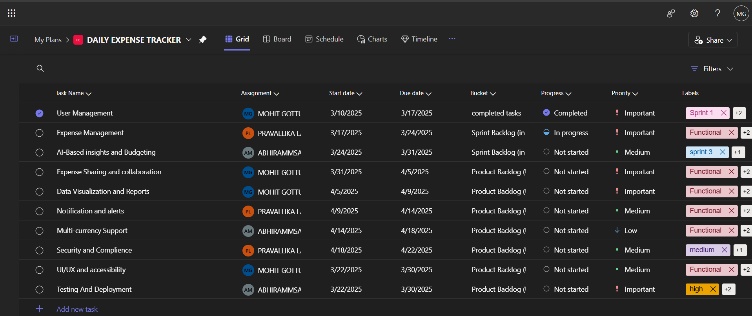
MS PLANNER

Slide 26
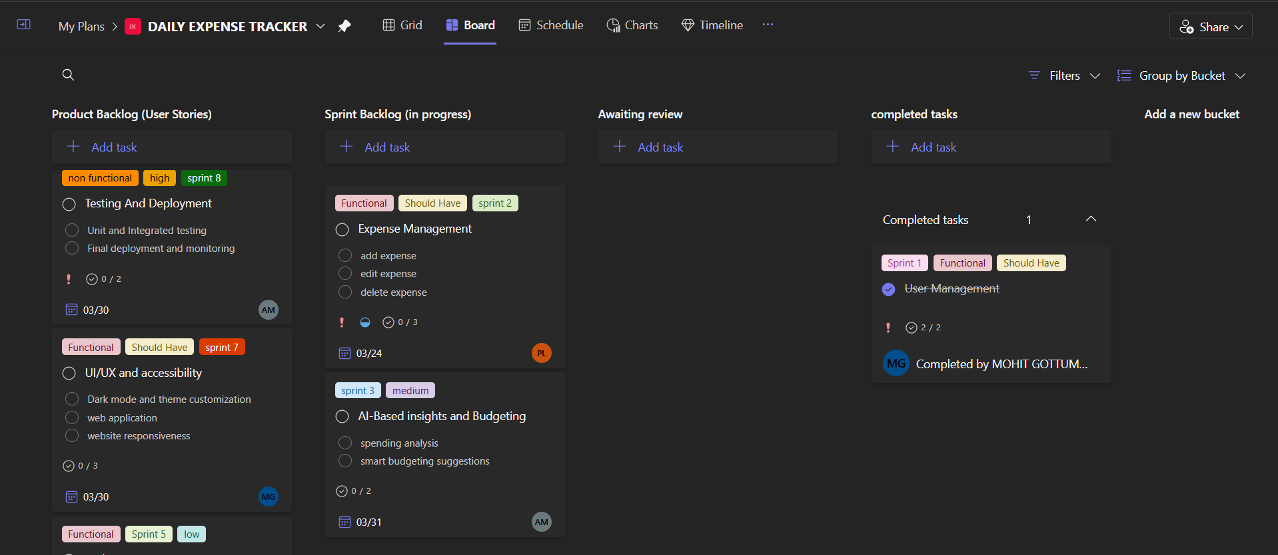
MS PLANNER

Slide 27
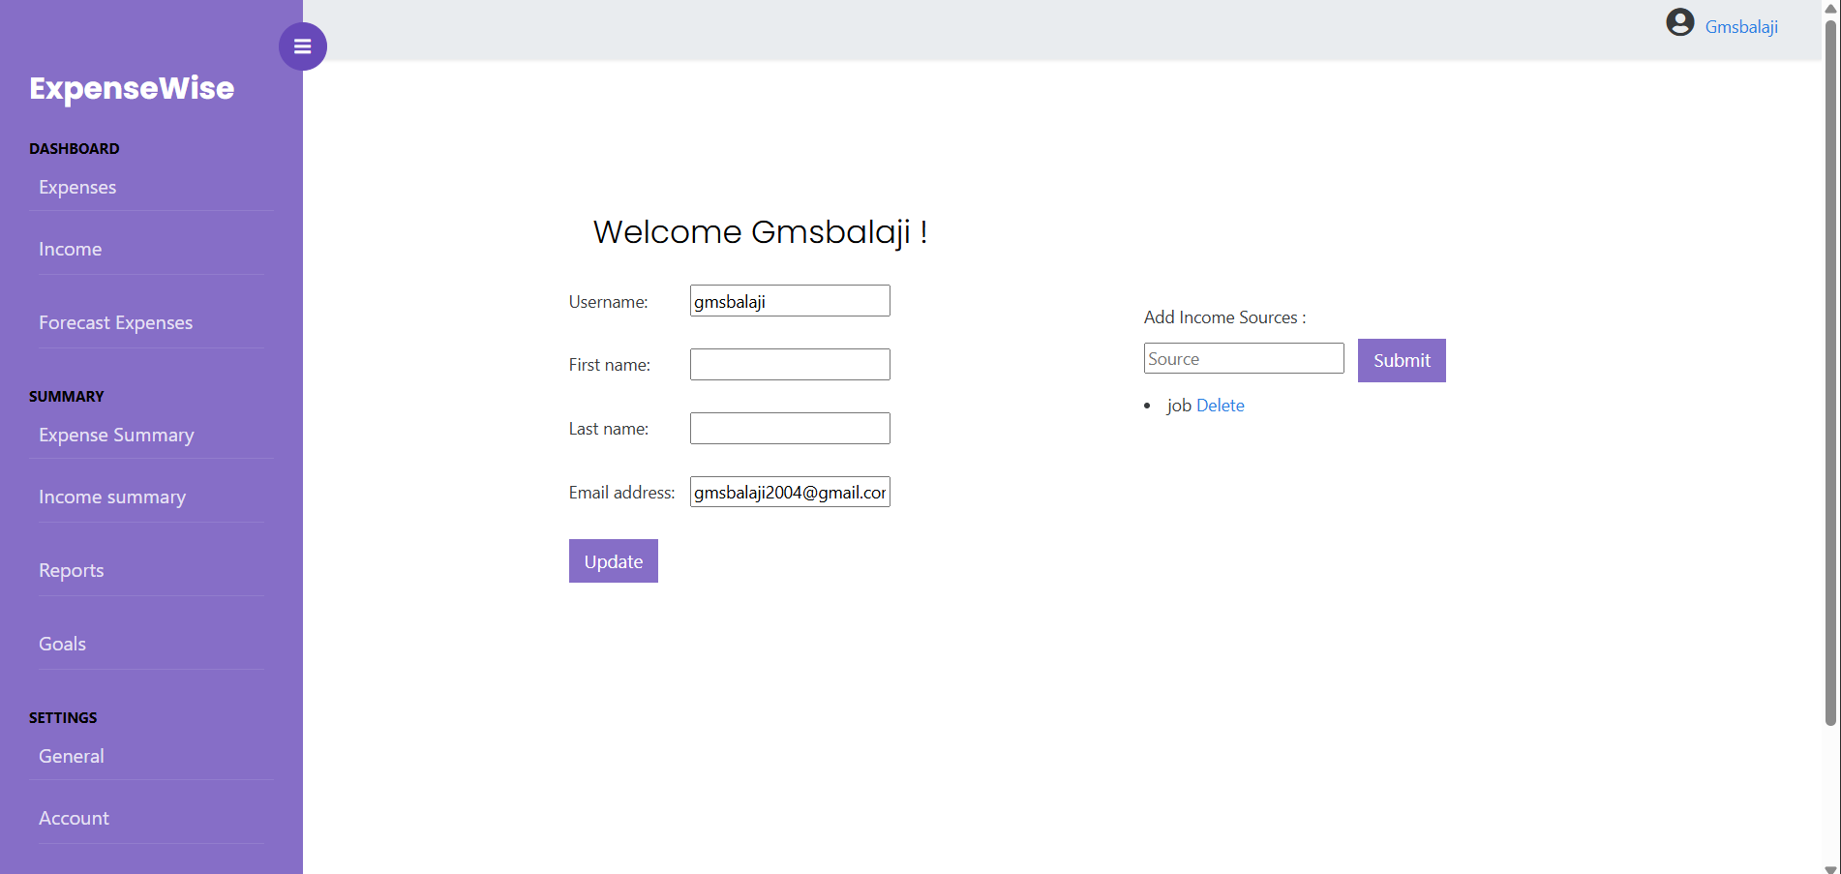
OUTPUTS

Slide 28
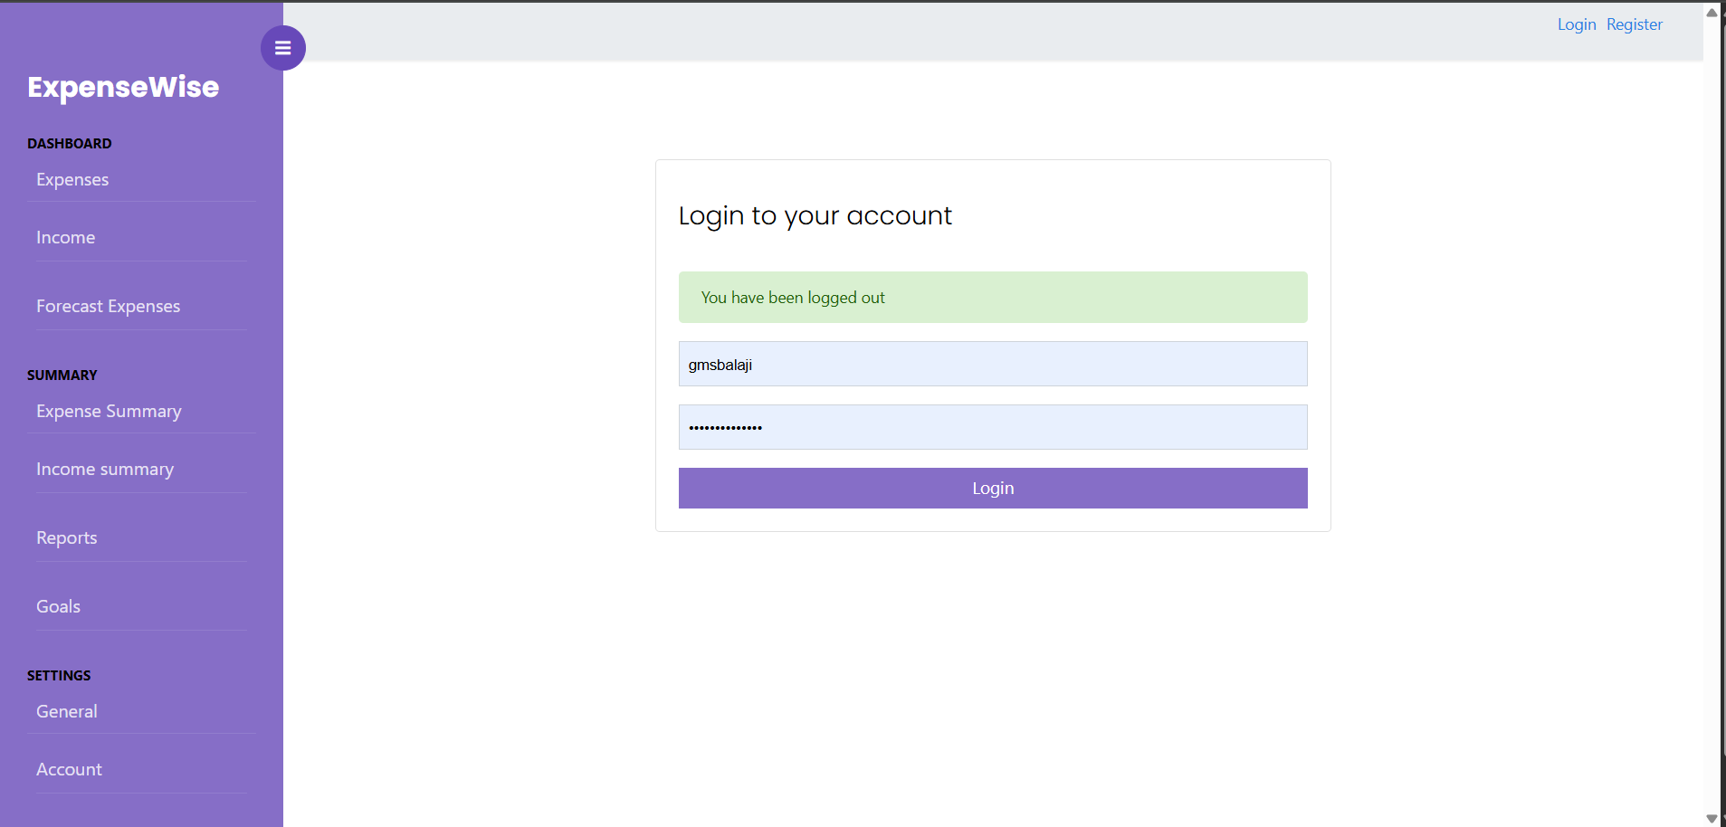
OUTPUTS

Slide 29
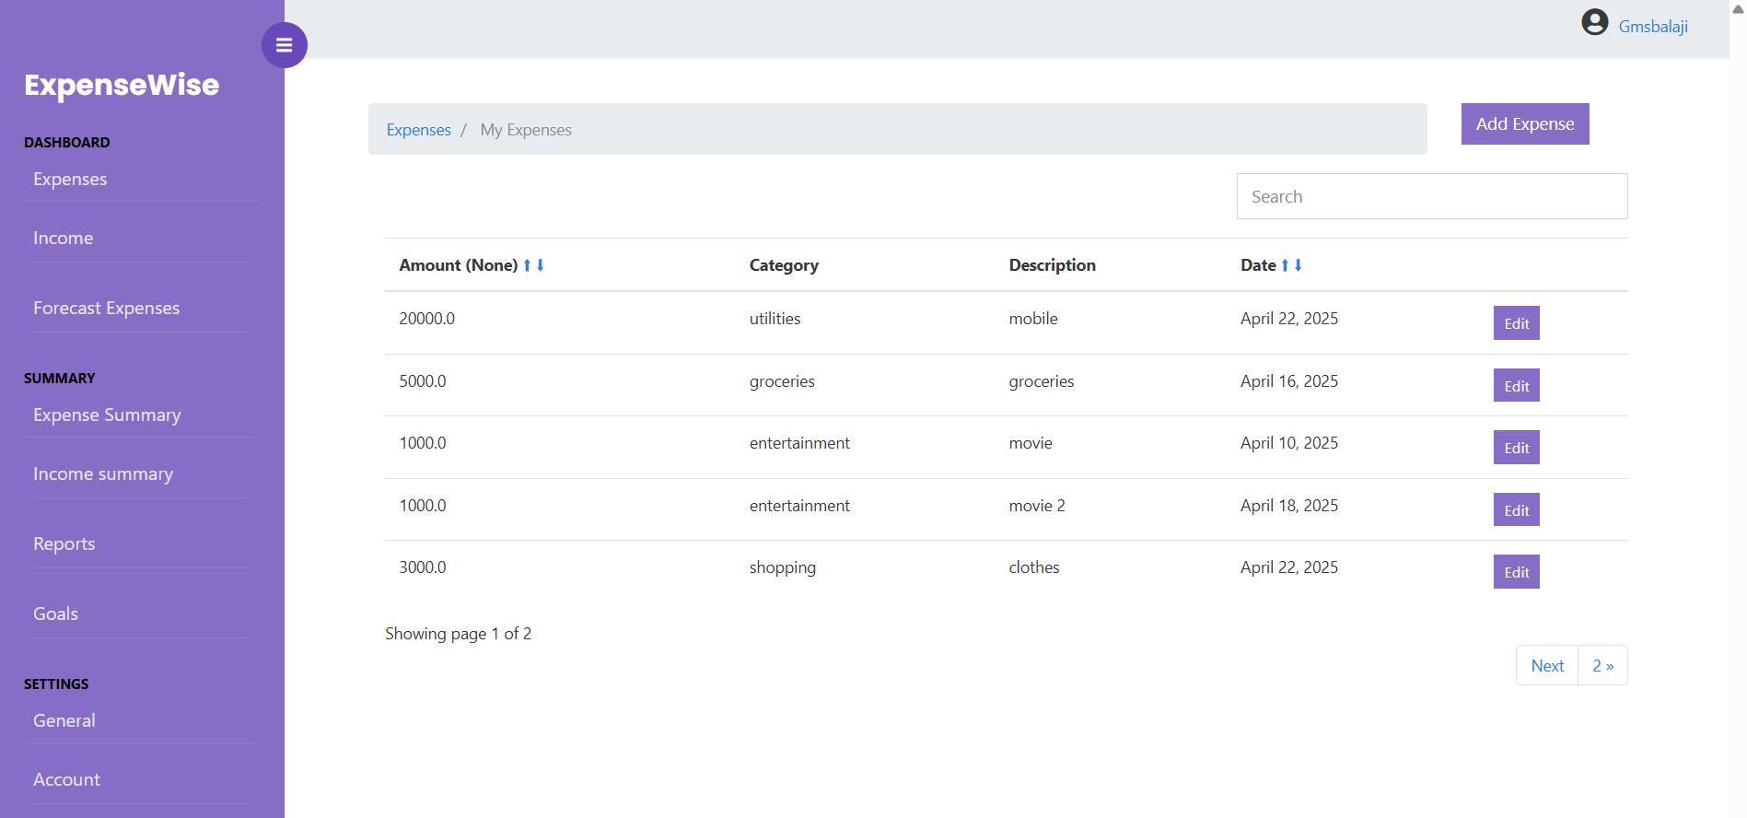
OUTPUTS

Slide 30
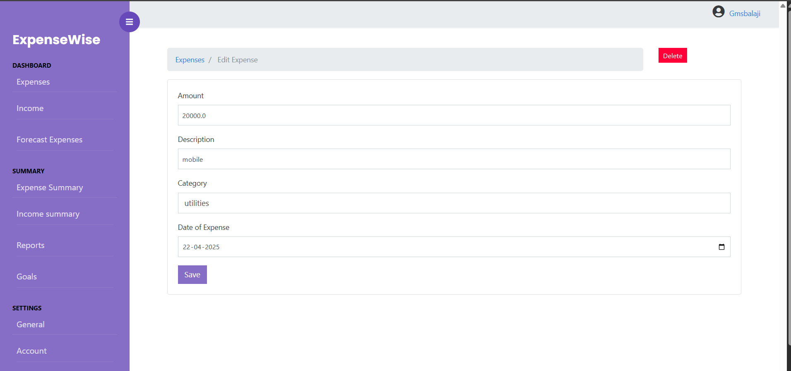
OUTPUTS

Slide 31
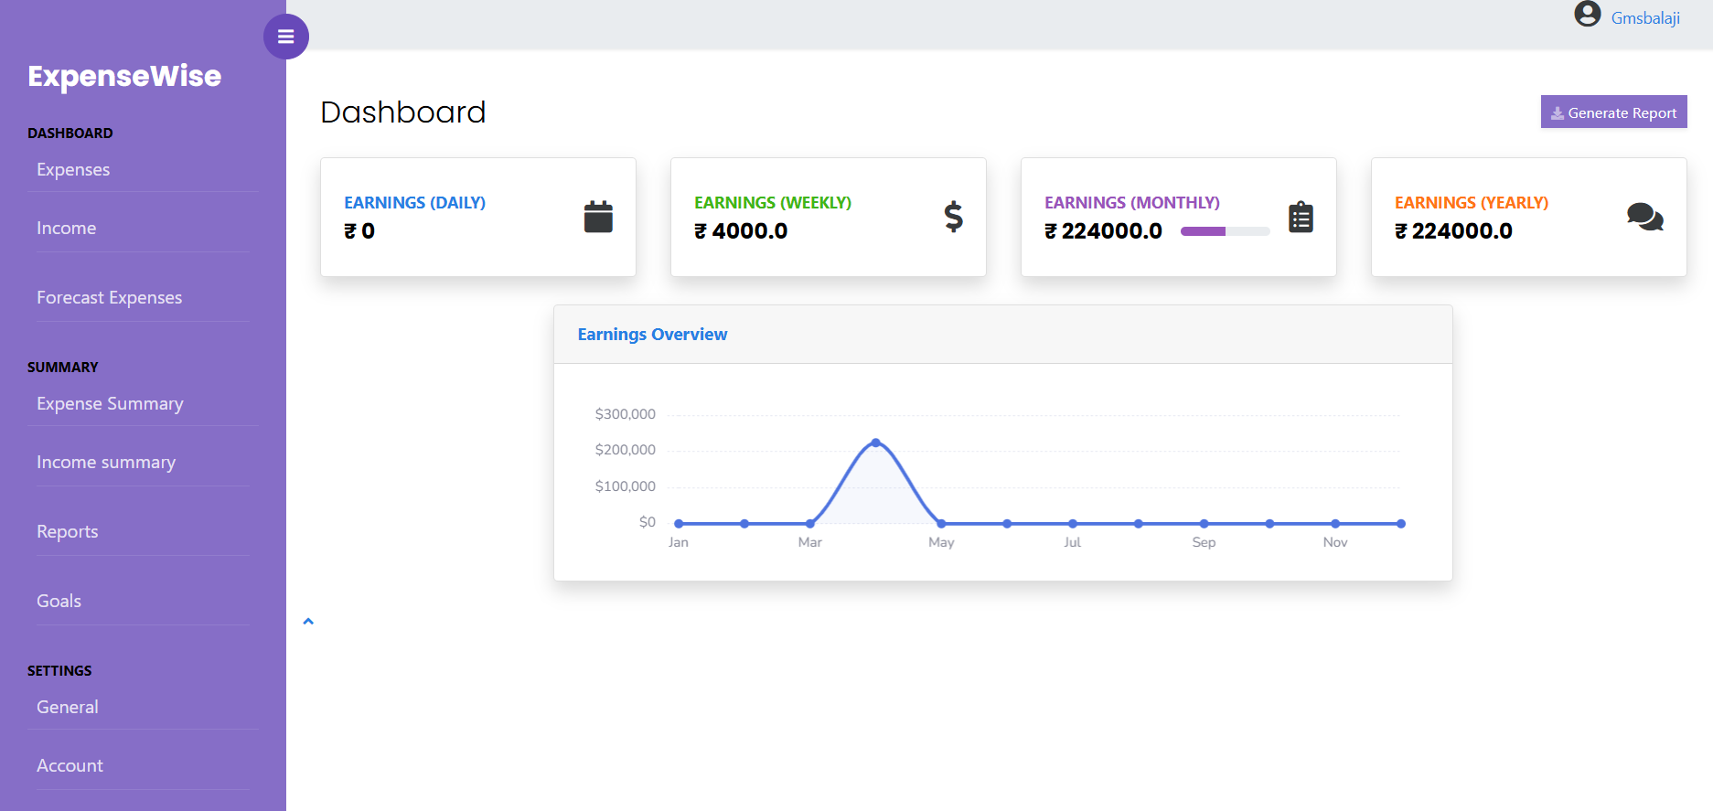
OUTPUTS

Slide 32
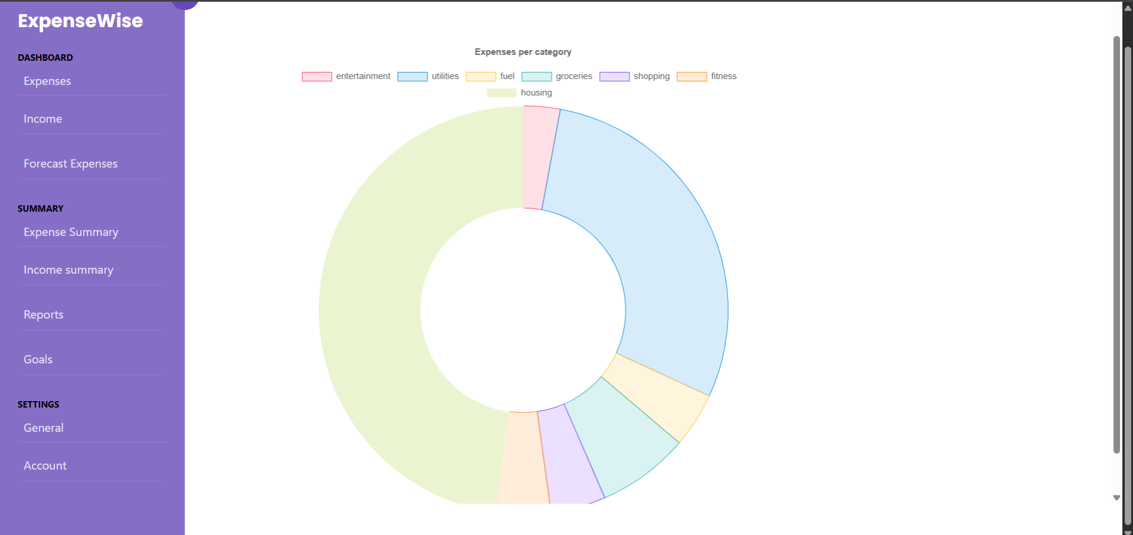
OUTPUTS

Slide 33
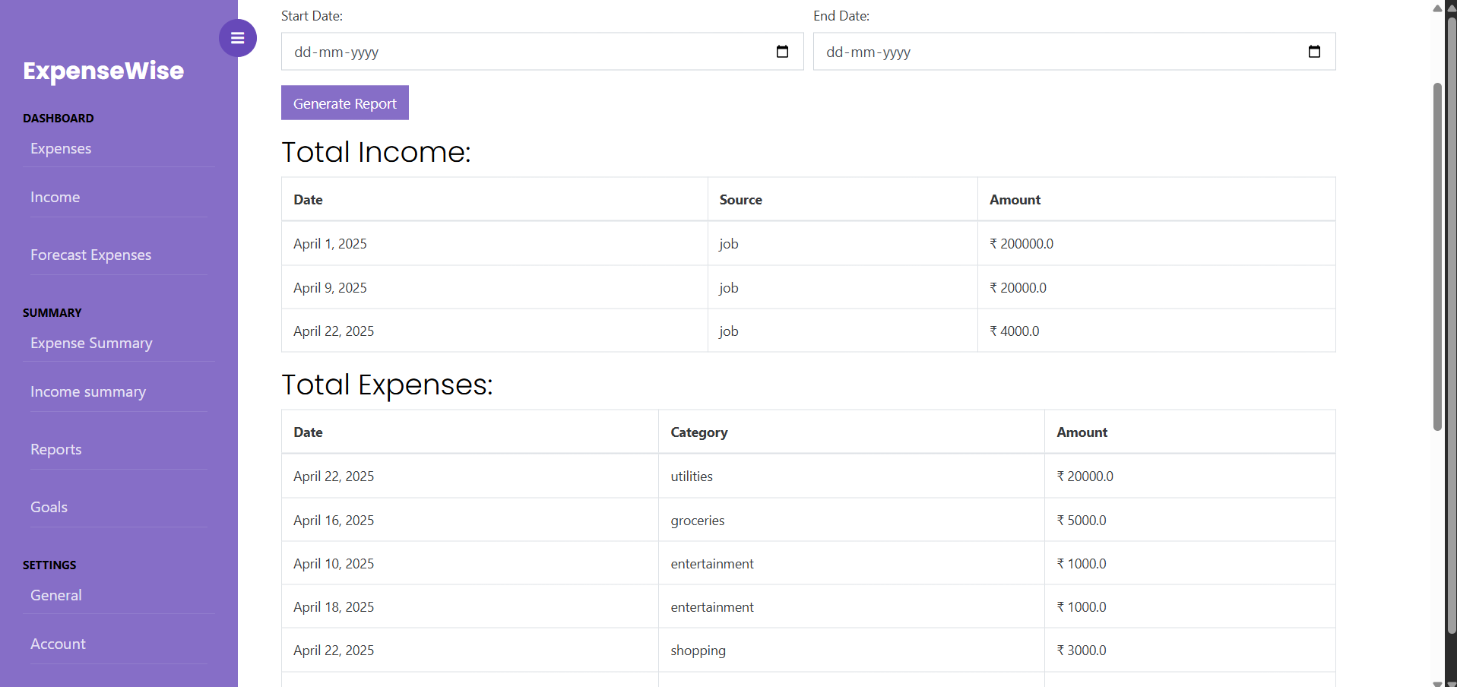
OUTPUTS

Slide 34
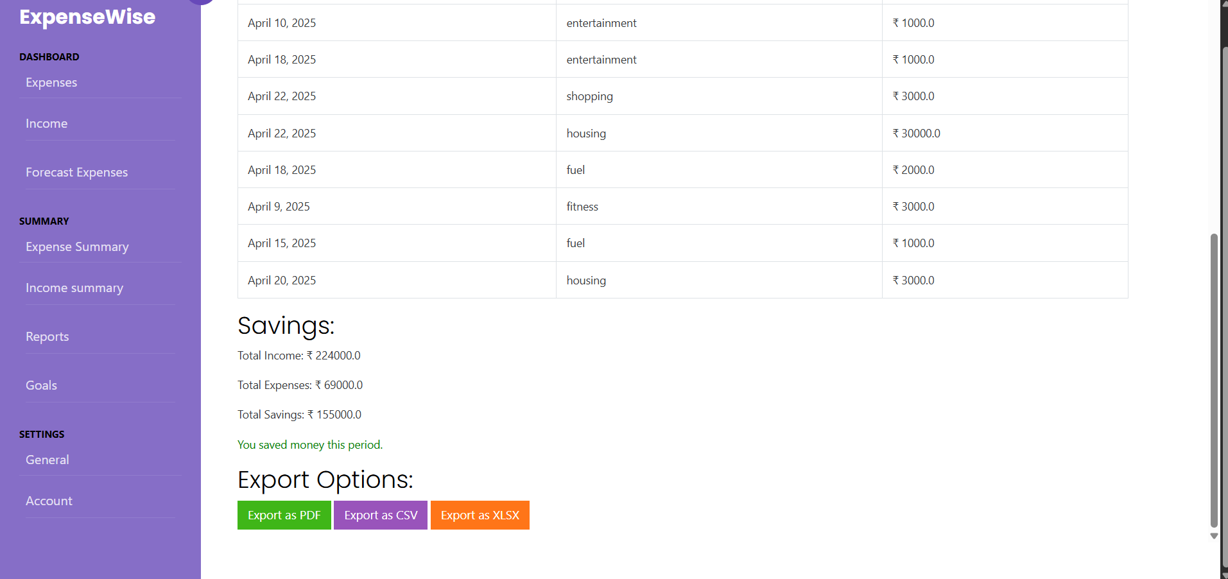
OUTPUTS

Slide 35
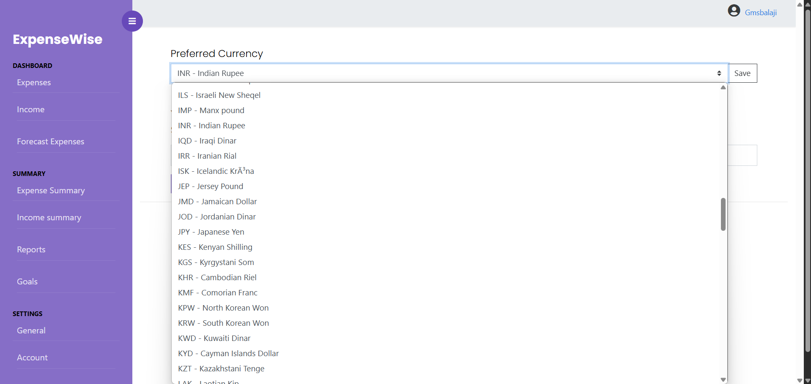
OUTPUTS

Slide 36
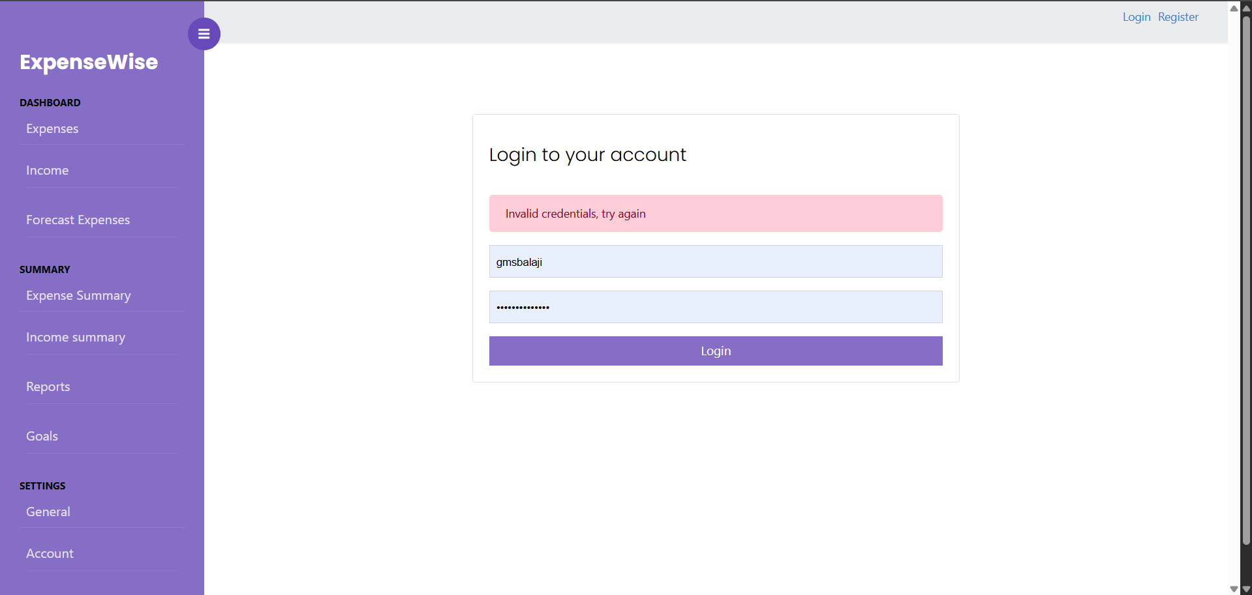
OUTPUTS

Slide 37
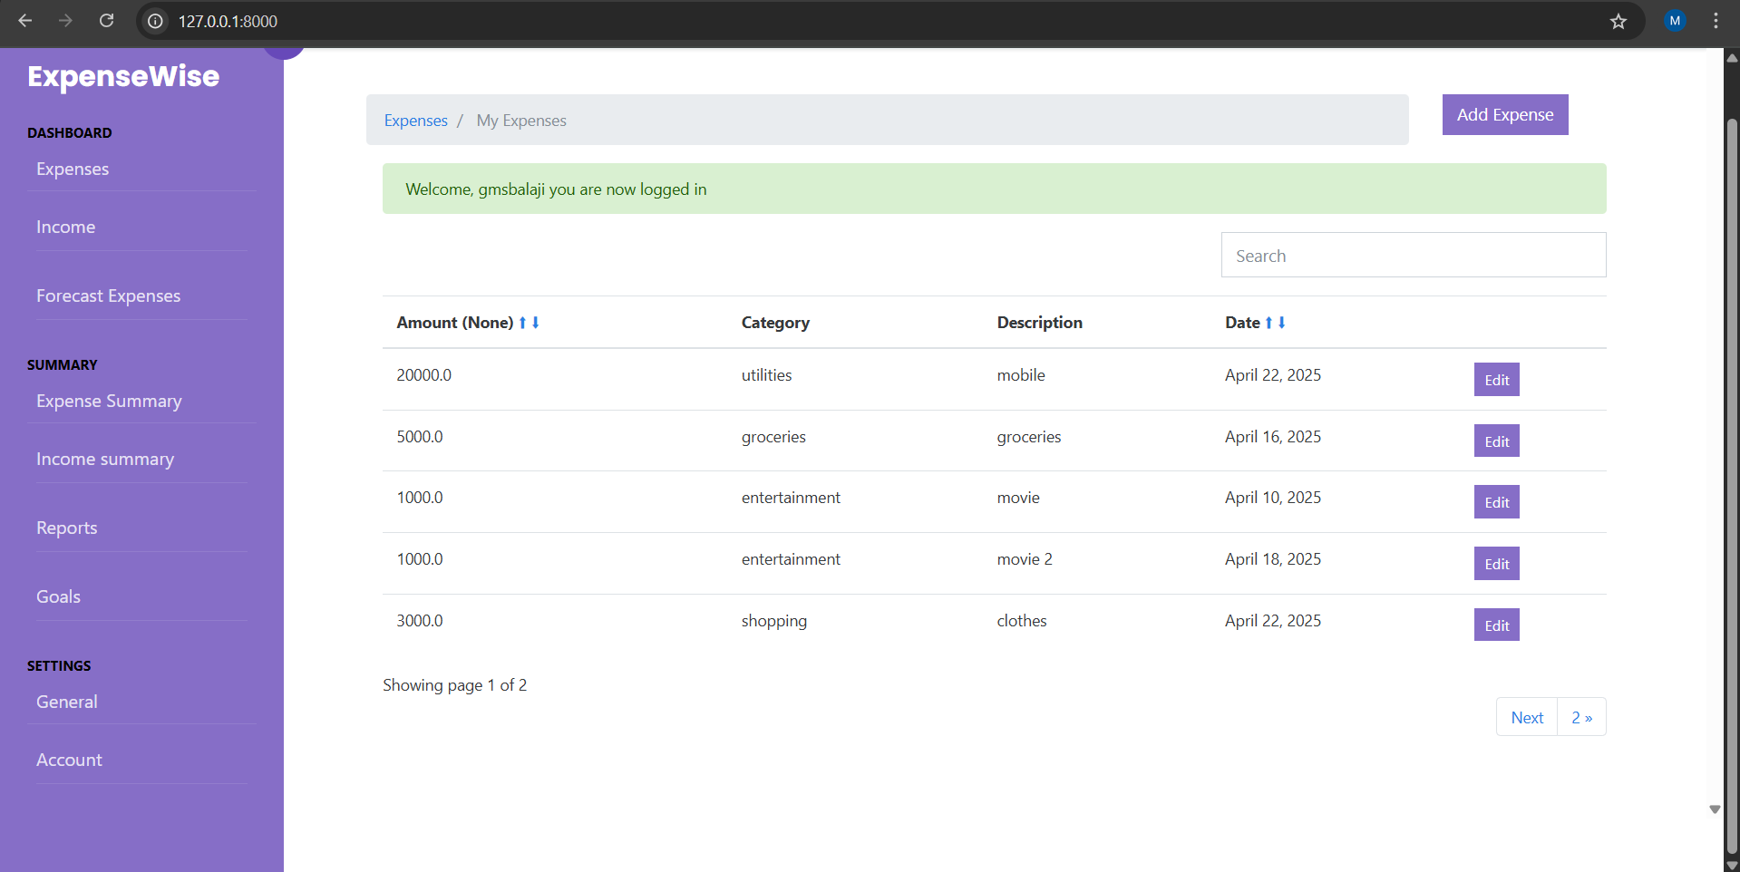
OUTPUTS

Slide 38
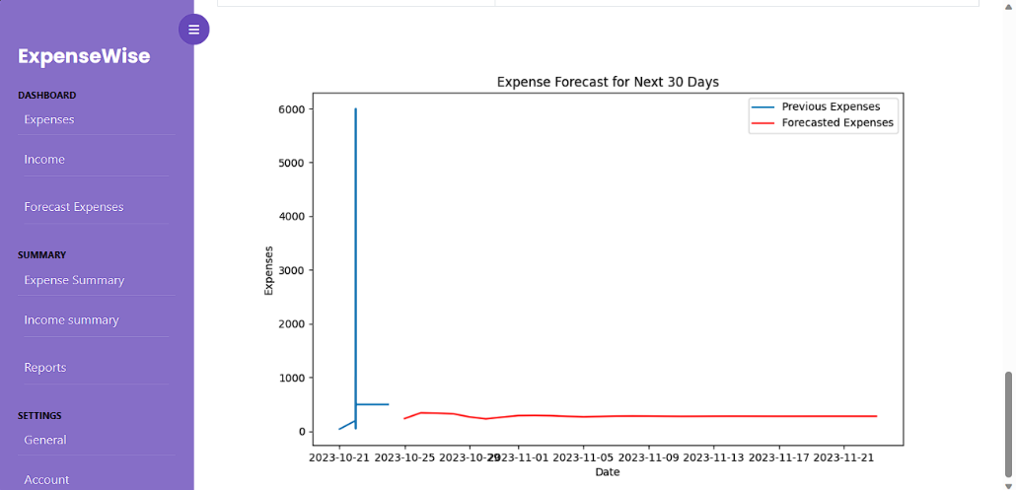
OUTPUTS

